Slide 1
Heart Disease Prediction
Saravanakumar G
(EBSLEM0322454664)

Slide 2
Contents:
Introduction
Problem statement
Objective
Examples
Algorithms
Applications
Summary

Slide 3
Introduction
It is difficult to identify heart disease because of several contributory risk factors such as diabetes, high blood pressure, high cholesterol, abnormal pulse rate and many other factors.
The diagnosis of heart disease is a challenging task, which can offer automated prediction about the heart condition of patient so that further treatment can be made effective.

Slide 4
The diagnosis of heart disease is usually based on signs, symptoms of the patient.
The nature of heart disease is complex and hence, the disease must be handled carefully. Not doing so many affect the heart or cause premature death.

Slide 5
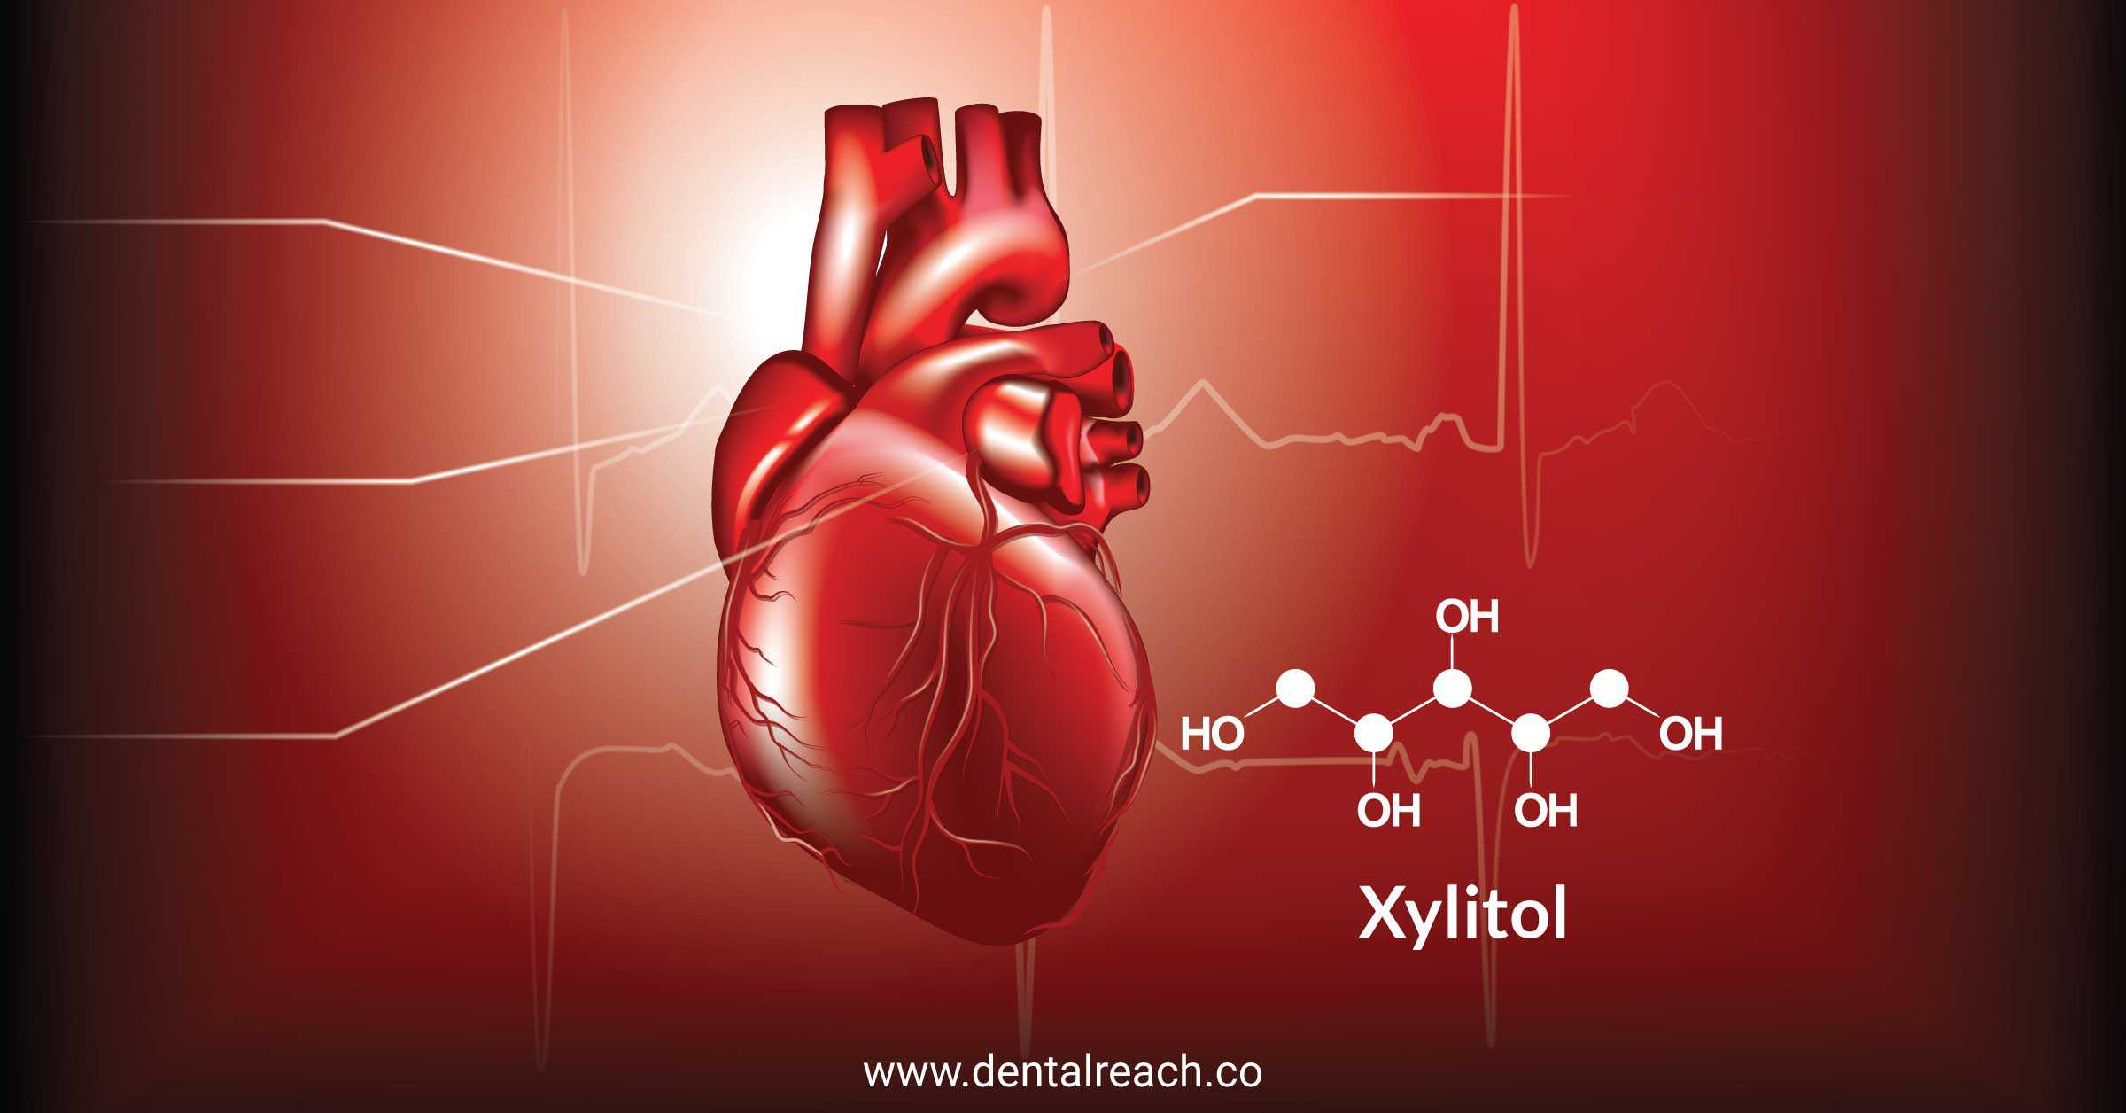
Problem statement
Heart disease prediction using machine learning algorithm.

Slide 6


Mandatory tools
Good laptop(above 4GB ram)
Anaconda Advanced version like 3.6
Jupiter lab or Note

Slide 7
Motivation
A major challenge facing healthcare organization is the provision of quality services at affordable cost.
Quality service employee diagnosing patients correctly and administering treatments that are effective.
Poor clinical decisions can lead to disastrous consequence which are therefore unacceptable

Slide 8
Hospitals must also minimize the cost of clinical tests.
They can achieve this result by employing appropriate computer based information and decision support system.

Slide 9
Objectives
The main objective of this research to develop a heart prediction systems, the system can discover and extract hidden knowledge associated with disease from heart data set.
Reduce the cost of medical test
Medical data set to assist in the prediction of the heart disease..

Slide 10
Machine learning
Machine learning (ML) is a type of artificial intelligence (AI) that allows software applications to become more accurate at predicting outcomes without being explicitly programmed to do so. Machine learning algorithms use historical data as input to predict new output values.

Slide 11
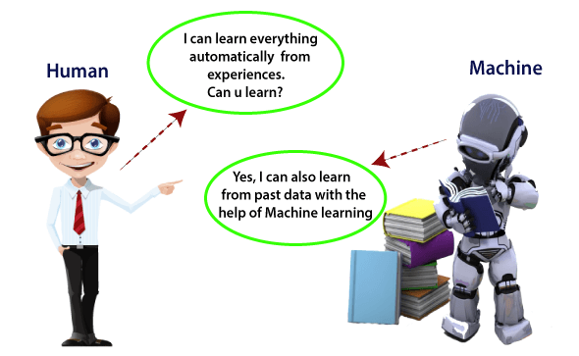

Slide 12
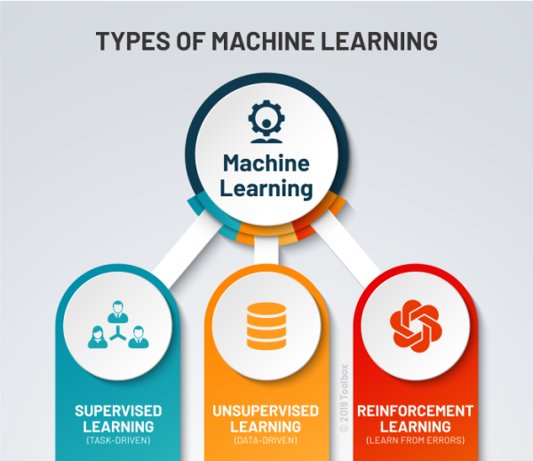

Slide 13
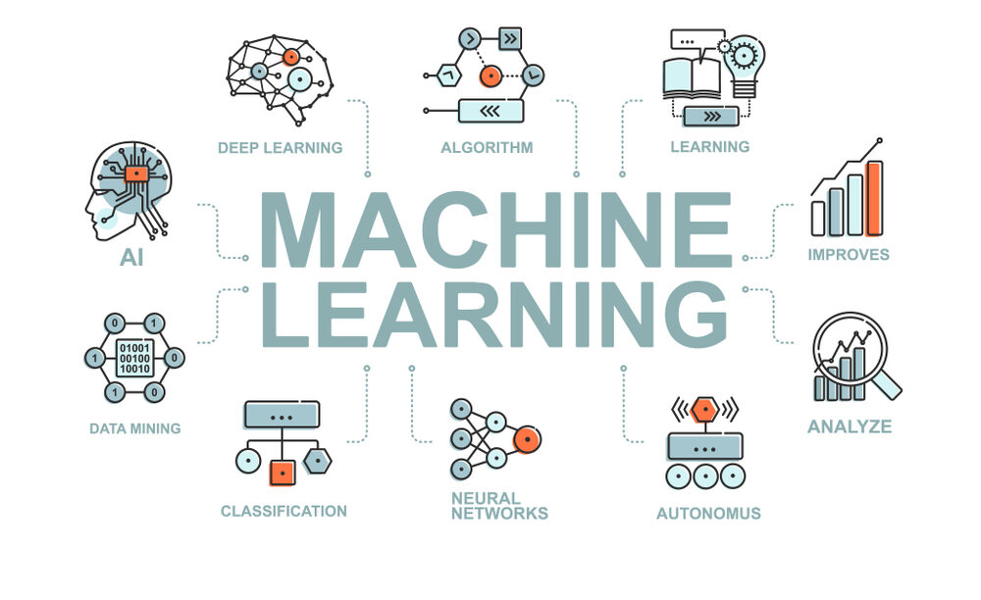

Slide 14
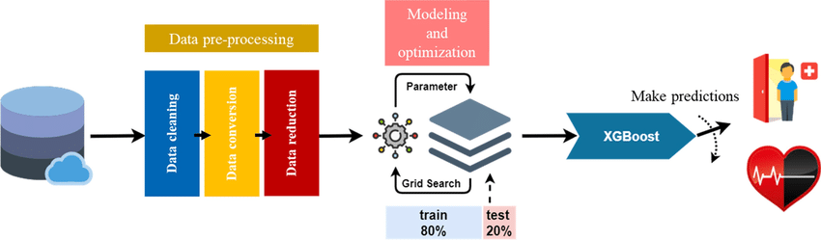
Proposed Model

Slide 15
Applications
Medical Institutions:
To teach medical students how the heart attack been measured or how to identify that the person is suffering from heart disease.
Hospitals:
To detect that is the person having heart disease or not

Slide 16
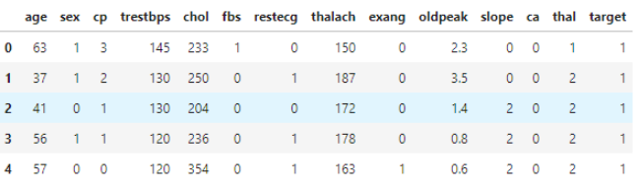
DATA

Slide 17
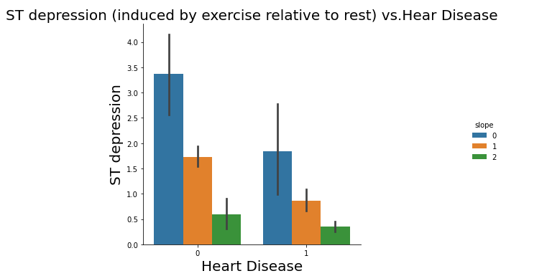

Slide 18
Exploratory Data Analysis
With EDA(Exploratory Data Analysis) we can able to understand our data better way.
In here we can find out how the data was distributed ,shape of data, relationship between variables.
The libraries used for EDA Pandas, Seaborn, Matplotlib,Sklearn

Slide 19
Algorithms
Logistic Regression
KNN
SVM
Naive Bayes
Decision Tree
Random Forest
XGBoost

Slide 20
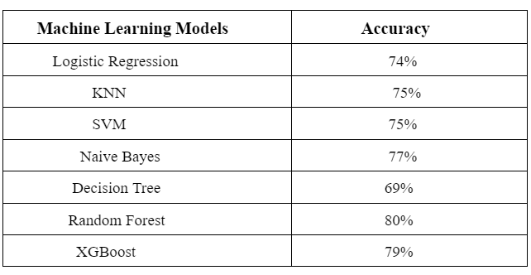
Predictions

Slide 21
From comparing the 7 models, we can conclude that Model 6: Random Forest yields the highest accuracy. With an accuracy of 80%. 🏆

Slide 22
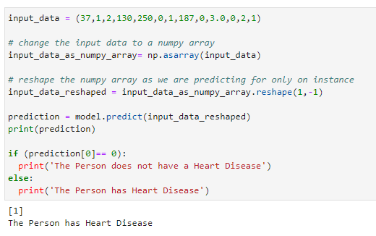

Slide 23
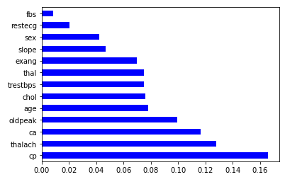

Slide 24
top 4 significant features were chest pain type (cp), maximum heart rate achieved (thalach), number of major vessels (ca), and ST depression induced by exercise relative to rest (oldpeak).

Slide 25
Conclusions
Our Random Forest algorithm yields the highest accuracy, 80%. Any accuracy above 70% is considered good, but be careful because if your accuracy is extremely high, it may be too good to be true (an example of Overfitting). Thus, 80% is the ideal accuracy!
Out of the 13 features we examined, the top 4 significant features that helped us classify between a positive & negative Diagnosis were chest pain type (cp), .

Slide 26
maximum heart rate achieved (thalach), number of major vessels (ca), and ST depression induced by exercise relative to rest (oldpeak).
Our machine learning algorithm can now classify patients with Heart Disease. Now we can properly diagnose patients, & get them the help they needs to recover. By diagnosing detecting these features early, we may prevent worse symtoms from arising later.

Slide 27


Slide 28
Thank you!

